Slide 2

GenFuzz: GPU-accelerated Hardware Fuzzing using Genetic Algorithm with Multiple Inputs
*Dian-Lun Lin, Yanqing Zhang, Haoxing Ren,
Shih-Hsin Wang, Brucek Khailany, and Tsung-Wei Huang
Notes:
Hello everyone, thanks attending this session. My name is dian-lun-lin. I'm a fourth-year PhD student at university of utah. Toady I'm gonna present our work: GenFuzz: GPU-accelearted hardware fuzzing using genetic algorithm with multiple inputs

Slide 3
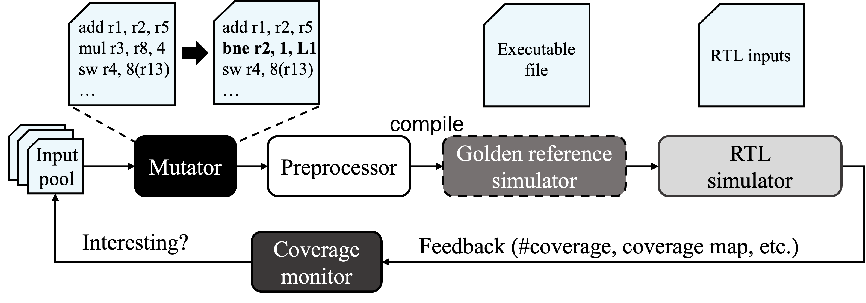
Hardware Fuzzing
The ever-increasing complexity of hardware design has put significant strain on System-on-Chip (SoC) designers and system integrators to detect and evaluate hardware vulnerabilities within the design stage
Hardware fuzzing has emerged as a promising automatic hardware verification technique to efficiently discover and verify hardware vulnerabilities
Very time-consuming due to feedback analysis
Notes:
what is hardware fuzzing and what’s the benefit of using hardware fuzzing. Well, we all know modern designs are very large, verification engineers or SoC designers typically need to manually create lots of inputs to verify a design, which put lots of strain on them.
And recently, hardware fuzzing has emerged as a promising automatic verification technique that allows you to efficiently discover and verify hardware bugs
As shown in the figure on the top, typical hardware fuzzing select one input at a time, and mutate the input by, for example, changing one instruction of the input. We then compile the RTL design and the input, and perform RTL simulation. After the simulation, we get the output data. Based on the output data, If we found that this input discover new state of the design, we consider it is interesting and push the input back to the input pool.
However, this process requires time-consuming feedback analysis that often takes hours or days to finish.

Slide 4

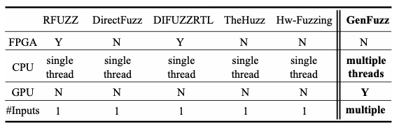
State-of-the-art Hardware Fuzzers
Notes:
Recent research has proposed several hardware fuzzing methods. While all these approaches have shown coverage or runtime improvements, nearly all of them are limited to single-input fuzzing using one CPU thread. They all perform single-input fuzzing as shown the figure on the top.
On the other hand, our work, GenFuzz, is a multi-input hardware fuzzer to fuzz multiple inputs in parallel using both CPU and GPU parallelisms

Slide 5
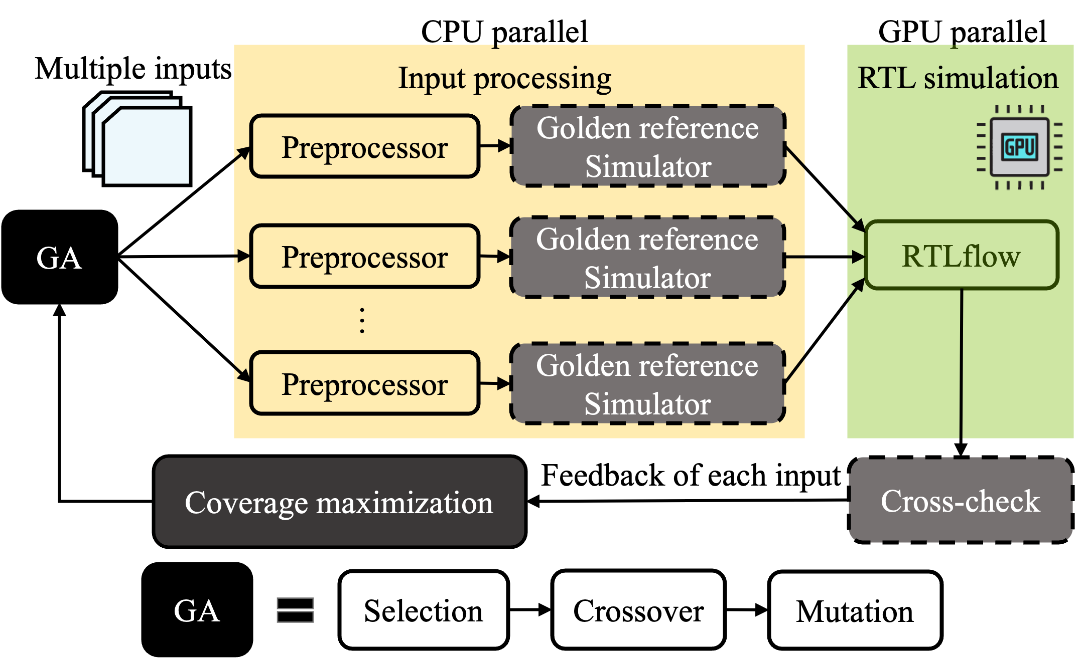
GenFuzz Overview
Notes:
At a high level, GenFuzz efficiently discovers new coverage by fuzzing multiple inputs in parallel. The graph in this slide shows the overview of GenFuzz. Our hardware fuzzing workload iterates five stages: GA (genetic algorihm), input processing, RTL simulation, cross-check and coverage maximization.
At the GA stage, GenFuzz generate new multiple inputs using our GA framework.
The next stage, input processing stage involves CPU-intensive tasks such as the compilation of simulation inputs
To improve runtime performance, we evenly distribute inputs across different CPUs to process each input in parallel.
For the RTL simulation part, we integrate RTLflow into GenFuzz to enable GPU acceleration for multi-stimulus RTL simulation.
RTLflow is our previous work that allows us to run multiple stimuli in parallel using GPU.
After the RTL simulation, we cross-check results derived from the reference simulator and RTLflow.
Finally, our coverage-maximization algorithm scores each input by analyzing the feedback of each input.
The fuzzing iteration continues until GA cannot find new coverage after a maximum number of iterations.
In the following slides, I’m gonna present our GA framework and our coverage maximization algorithm.

Slide 6
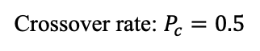
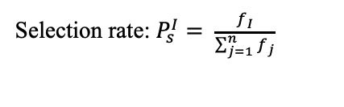
GA-based Framework for solving multi-input fuzzing
Input pool
Fitness: 32
Fitness: 28
Selection rate: $P_{s}^{I}= \frac{f_{I}}{\sum_{j=1}^{n}{f_{j}}}$
add r1, r2, r5
mul r3, r8, 4
sw r4, 8(r13)
slli r9, r9, 19
jalr r8, 0(r6)
Roulette-Wheel
Selection
Fitness: 32
Fitness: 28
add r1, r2, r5
mul r3, r8, 4
sw r4, 8(r13)
slli r9, r9, 19
jalr r8, 0(r6)
Fitness: 2
Fitness: 11
xor r8, r8, r4
la r1, d_3_3
Gene
…
Individual
Parent
1-point Crossover
mul r3, r8, 4
sw r4, 8(r13)
lui x1, 1
add r1, r2, r5
mul r3, r8, 4
sw r4, 8(r13)
slli r9, r9, 19
jalr r8, 0(r6)
add r1, r2, r5
xor r1, r1, r2
Mutation
add r1, r2, r5
_replace
_delete
mul r3, r8, 4
sw r4, 8(r13)
_insert
add r1, r2, r5
jalr r8, 0(r6)
slli r9, r9, 19
mul r3, r8, 4
sw r4, 8(r13)
Crossover rate: $P_{c}=0.5$
Notes:
The goal of our GA-based framework is to produce new inputs that can maximally extend coverage using results from the previous fuzzing iteration. Our GA consists of selection, crossover, and mutation. Unlike existing mutation approaches that only select one input to mutate, our GA framework generate multiple inputs by exchanging interesting instructions between parents.
The graph in the slide shows the overview of our GA-based framework.
Now let’s go through the algorithm step by step.

Slide 7
GA-based Framework for solving multi-input fuzzing
Input pool
Fitness: 32
Fitness: 28
Selection rate: $P_{s}^{I}= \frac{f_{I}}{\sum_{j=1}^{n}{f_{j}}}$
add r1, r2, r5
mul r3, r8, 4
sw r4, 8(r13)
slli r9, r9, 19
jalr r8, 0(r6)
Roulette-Wheel
Selection
Fitness: 32
Fitness: 28
add r1, r2, r5
mul r3, r8, 4
sw r4, 8(r13)
slli r9, r9, 19
jalr r8, 0(r6)
Fitness: 2
Fitness: 11
xor r8, r8, r4
la r1, d_3_3
Gene
…
Individual
Parent
1-point Crossover
mul r3, r8, 4
sw r4, 8(r13)
lui x1, 1
add r1, r2, r5
mul r3, r8, 4
sw r4, 8(r13)
slli r9, r9, 19
jalr r8, 0(r6)
add r1, r2, r5
xor r1, r1, r2
Mutation
add r1, r2, r5
_replace
_delete
mul r3, r8, 4
sw r4, 8(r13)
_insert
add r1, r2, r5
jalr r8, 0(r6)
slli r9, r9, 19
mul r3, r8, 4
sw r4, 8(r13)
Crossover rate: $P_{c}=0.5$
Notes:
Each gene represents an instruction, and each individual consists of multiple genes to form an input.

Slide 8
GA-based Framework for solving multi-input fuzzing
Input pool
Fitness: 32
Fitness: 28
Selection rate: $P_{s}^{I}= \frac{f_{I}}{\sum_{j=1}^{n}{f_{j}}}$
add r1, r2, r5
mul r3, r8, 4
sw r4, 8(r13)
slli r9, r9, 19
jalr r8, 0(r6)
Roulette-Wheel
Selection
Fitness: 32
Fitness: 28
add r1, r2, r5
mul r3, r8, 4
sw r4, 8(r13)
slli r9, r9, 19
jalr r8, 0(r6)
Fitness: 2
Fitness: 11
xor r8, r8, r4
la r1, d_3_3
Gene
…
Individual
Parent
1-point Crossover
mul r3, r8, 4
sw r4, 8(r13)
lui x1, 1
add r1, r2, r5
mul r3, r8, 4
sw r4, 8(r13)
slli r9, r9, 19
jalr r8, 0(r6)
add r1, r2, r5
xor r1, r1, r2
Mutation
add r1, r2, r5
_replace
_delete
mul r3, r8, 4
sw r4, 8(r13)
_insert
add r1, r2, r5
jalr r8, 0(r6)
slli r9, r9, 19
mul r3, r8, 4
sw r4, 8(r13)
Crossover rate: $P_{c}=0.5$
Notes:
The selection process chooses individuals with higher fitness from the input pool. For example, the fitness with 32 and 28 are selected. We apply Roulette-Wheel Selection (RWS) for our framework such that the probability of choosing an individual is proportional to its fitness.
We will present how GenFuzz calculates fitness in later slide.

Slide 9
GA-based Framework for solving multi-input fuzzing
Input pool
Fitness: 32
Fitness: 28
Selection rate: $P_{s}^{I}= \frac{f_{I}}{\sum_{j=1}^{n}{f_{j}}}$
add r1, r2, r5
mul r3, r8, 4
sw r4, 8(r13)
slli r9, r9, 19
jalr r8, 0(r6)
Roulette-Wheel
Selection
Fitness: 32
Fitness: 28
add r1, r2, r5
mul r3, r8, 4
sw r4, 8(r13)
slli r9, r9, 19
jalr r8, 0(r6)
Fitness: 2
Fitness: 11
xor r8, r8, r4
la r1, d_3_3
Gene
…
Individual
Parent
1-point Crossover
mul r3, r8, 4
sw r4, 8(r13)
lui x1, 1
add r1, r2, r5
mul r3, r8, 4
sw r4, 8(r13)
slli r9, r9, 19
jalr r8, 0(r6)
add r1, r2, r5
xor r1, r1, r2
Mutation
add r1, r2, r5
_replace
_delete
mul r3, r8, 4
sw r4, 8(r13)
_insert
add r1, r2, r5
jalr r8, 0(r6)
slli r9, r9, 19
mul r3, r8, 4
sw r4, 8(r13)
Crossover rate: $P_{c}=0.5$
Notes:
The crossover process allows parents to exchange instructions for producing the next generation of individuals. We choose two parents from selected individuals and apply one-point crossover. As shown in the figure, genes of both parents after the crossover point (red line) are interchanged. For example, the left child has add r1, r2, r5 from the left parent and jalr r8, 0(r6) from the right parent.

Slide 10
GA-based Framework for solving multi-input fuzzing
Input pool
Fitness: 32
Fitness: 28
Selection rate: $P_{s}^{I}= \frac{f_{I}}{\sum_{j=1}^{n}{f_{j}}}$
add r1, r2, r5
mul r3, r8, 4
sw r4, 8(r13)
slli r9, r9, 19
jalr r8, 0(r6)
Roulette-Wheel
Selection
Fitness: 32
Fitness: 28
add r1, r2, r5
mul r3, r8, 4
sw r4, 8(r13)
slli r9, r9, 19
jalr r8, 0(r6)
Fitness: 2
Fitness: 11
xor r8, r8, r4
la r1, d_3_3
Gene
…
Individual
Parent
1-point Crossover
mul r3, r8, 4
sw r4, 8(r13)
lui x1, 1
add r1, r2, r5
mul r3, r8, 4
sw r4, 8(r13)
slli r9, r9, 19
jalr r8, 0(r6)
add r1, r2, r5
xor r1, r1, r2
Mutation
add r1, r2, r5
_replace
_delete
mul r3, r8, 4
sw r4, 8(r13)
_insert
add r1, r2, r5
jalr r8, 0(r6)
slli r9, r9, 19
mul r3, r8, 4
sw r4, 8(r13)
Crossover rate: $P_{c}=0.5$
Notes:
The mutation process provides a mechanism for newborn inputs to create more diversity. During the mutation phase, we iterate each gene in an individual and decide if the gene is mutated using the muation rate. Our mutation contains three operators: insert, delete, and replace as shown in the left figure. Once mutation occurs, we randomly choose one operator to mutate the gene.
For example, the left child here, when we iterate to jarlr r8, 0(r6), we mutate this instruction and insert a _replace flag. And finally, this replace flag is changed to xor r1, r1, r2.

Slide 11
GA-based Framework for solving multi-input fuzzing
Input pool
Fitness: 32
Fitness: 28
Selection rate: $P_{s}^{I}= \frac{f_{I}}{\sum_{j=1}^{n}{f_{j}}}$
add r1, r2, r5
mul r3, r8, 4
sw r4, 8(r13)
slli r9, r9, 19
jalr r8, 0(r6)
Roulette-Wheel
Selection
Fitness: 32
Fitness: 28
add r1, r2, r5
mul r3, r8, 4
sw r4, 8(r13)
slli r9, r9, 19
jalr r8, 0(r6)
Fitness: 2
Fitness: 11
xor r8, r8, r4
la r1, d_3_3
Gene
…
Individual
Parent
1-point Crossover
mul r3, r8, 4
sw r4, 8(r13)
lui x1, 1
add r1, r2, r5
mul r3, r8, 4
sw r4, 8(r13)
slli r9, r9, 19
jalr r8, 0(r6)
add r1, r2, r5
xor r1, r1, r2
Mutation
add r1, r2, r5
_replace
_delete
mul r3, r8, 4
sw r4, 8(r13)
_insert
add r1, r2, r5
jalr r8, 0(r6)
slli r9, r9, 19
mul r3, r8, 4
sw r4, 8(r13)
Crossover rate: $P_{c}=0.5$
Notes:
The mutated inputs then become new inputs and are complied and simulated in later simulation stage.
The fitness is calculated based on coverage. Based on fitness, we then start selection-crossover-mutation process again.

Slide 12
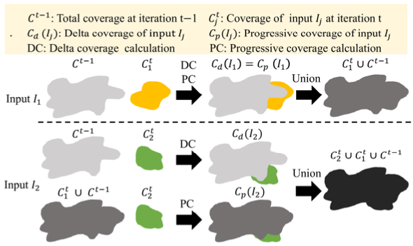
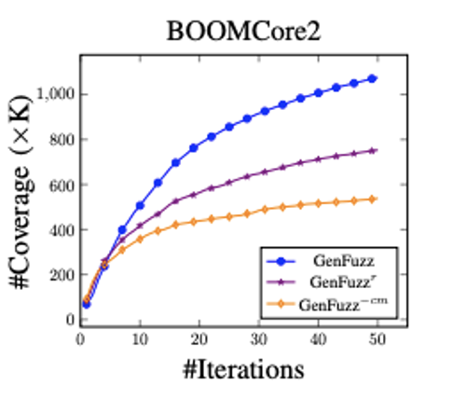
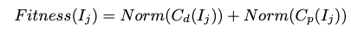
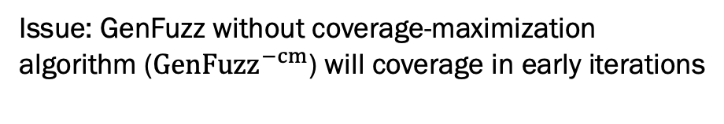
Coverage-Maximization Algorithm
Issue: GenFuzz without coverage-maximization
algorithm (${GenFuzz}^{−cm}$) will coverage in early iterations
Notes:
How do we calculate fitness?
One main issue of multi-input hardware fuzzing is that it introduces inefficiency due to highly overlapped coverage within a fuzzing iteration. Since we fuzz multiple inputs per iteration, If we do not have a good calculation of fitness, we will produce lots of inputs that have very similar coverage
The left figure shows number of coverage over increasing number of iterations. The y-axis is the number of coverage we achieved.
GenFuzz minus cm, the orange line is GenFuzz without coverage-maximization algorithm.
We can see GenFuzz –inus cm quickly converges in early iterations.
To solve this problem, we propose a coverage-maximization algorithm. At high-level, our coverage-maximization algorithm can distinguish the coverage overlap within a fuzzing iteration and will minimize the overlap effect when calculating the fitness. Due to limited time, For the algorithm details, please refer to our paper.

Slide 13
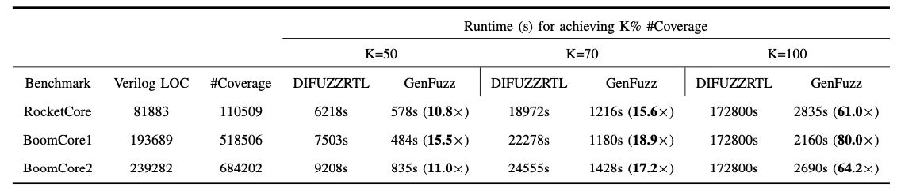
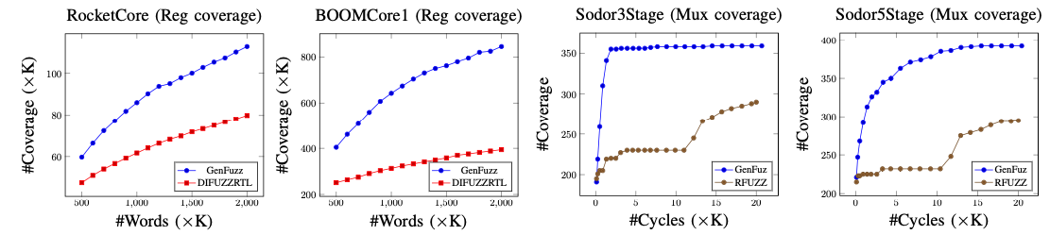
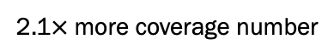
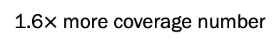
Experimental Results
2.1$×$more coverage number
1.6$×$more coverage number
Notes:
Table on the top of the slide compares the overall runtime between GenFuzz and the state of the art on different designs.
By fuzzing multiple inputs in parallel, GenFuzz becomes much faster than state of the art to achieve the same amount of coverage.
The maximum speedup we can get is roughly 80 times
Figures on the bottom of the slides compare the coverage throughput on different designs. Here we want to show by using the same amount of inputs, or instructions, whether we can perform better than state of the arts.
The x-axis is number of words and cycles, which is similar and proportional to number of instructions, and the y-axis is the number of coverage we achieve.
By our experimental results, we found that when compared to state of the art. GenFuzz can achieve 2.1× speed-up and 1.6x speed-up by using the same amount of the instructions.

Slide 14
Conclusion
GenFuzz is an efficient multi-input hardware fuzzer to fuzz multiple inputs simultaneously using both CPU and GPU parallelisms
We have presented an effective GA-based framework to iteratively produce multiple inputs of interest that are most likely to extend the coverage
We have presented a novel coverage-maximization algorithm to avoid overlapped coverage for both inter- and intra- fuzzing iterations
Notes:
In this paper,
We have presented an efficient multi-input hardware fuzzer to fuzz multiple inputs in parallel using both CPU and GPU parallelisms.
We also presented an effective GA-based framework to produce interesting inputs
Finally, we have presented a novel coverage-maximization algorithm to avoid overlapped coverage during fuzzing.
Thanks for listening

